Slide 1

7th Grade Accelerated Math
Unit 3, Lesson 1 Product Laws of Exponents Volume 1, pg. 99

Slide 2


Benchmark
MA.7.NSO.1.1
Know and apply the Laws of Exponents to evaluate numerical expressions and generate equivalent numerical expressions, limited to whole-number exponents and rational number bases.
volume 1, pg. 99

Slide 3
Integrated Mathematical Thinking and Reasoning Standards
MA.K12.MTR.1.1 Actively participate in effortful learning both individually and collectively.
MA.K12.MTR.4.1 Engage in discussions that reflect on the mathematical thinking of self and others.
MA.K12.MTR.5.1 Use patterns and structure to help understand and connect mathematical concepts.
MA.K12.MTR.6.1 Assess the reasonableness of solutions.
volume 1, pg. 99

Slide 4

Learning Target
I can explain and use the power of a product, power of a power, product of powers, and identity laws of exponents.
volume 1, pg. 99

Slide 5

Warm-Up
volume 1, pg. 99

Slide 6
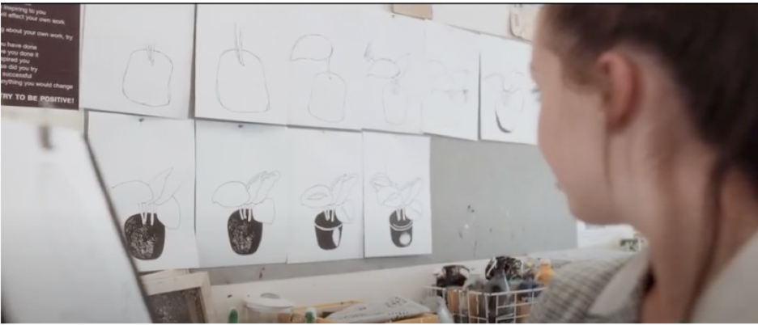
3.1.1 Warm-Up: Help You Grow
Two artists are drawing a plant. As they go through the process, both artists make mistakes and start over on their drawings. One of the artists crumples their papers up and throws them on the floor. The other artist hangs them on the wall next to where she is working.
What do you think is the purpose of hanging up the drawings with mistakes?
volume 1, pg. 99

Slide 7

Exploration
volume 1, pg. 100

Slide 8

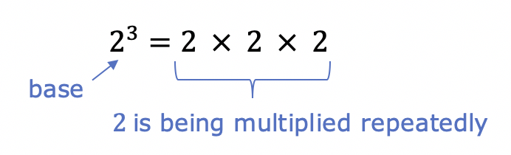

3.1.2 Exploration: Product of Powers Exponent Law
Recall that repeated multiplication is a way of writing a number with an exponent.
The number 2, called the base, is being multiplied repeatedly.
A base is the number used as a factor in exponential form.
volume 1, pg. 100

Slide 9
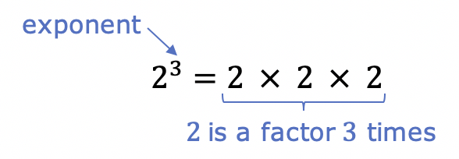
Since the base, 2, is a factor 3 times, the exponent is 3.
An exponent is the number of times the base occurs as a factor.
With your partner, use the definition of an exponent to complete the table.
Write each product as a repeated multiplication expression. Then, write each expression with an exponent.
volume 1, pg. 100

Slide 10
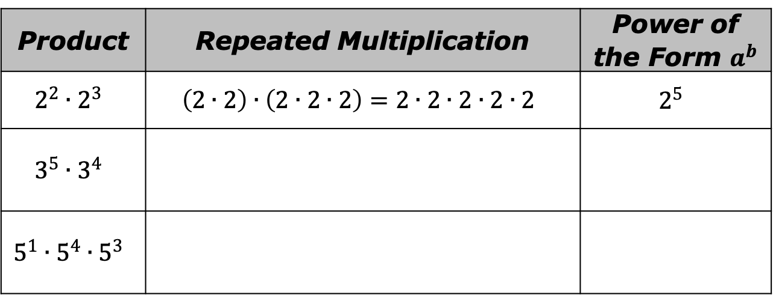
Product | Repeated Multiplication | Power of the Form $a^{b}$
$$2^{2}∙2^{3}$$ | $$\left(2∙2\right)∙\left(2∙2∙2\right)=2∙2∙2∙2∙2$$ | $$2^{5}$$
$$3^{5}∙3^{4}$$
$$5^{1}∙5^{4}∙5^{3}$$
How do the exponents in the first column relate to the exponents in the last column?
What do you notice about the bases in all three columns?
volume 1, pg. 100

Slide 11

Write a rule for the product of two exponential expressions with the same base.
Product of Powers Exponent Law
When multiplying two powers that have the same nonzero base, the exponents and keep the same base.
volume 1, pg. 100

Slide 12
With your partner, follow the steps.
Determine which column you will start in, and which column your partner will start in.
Using the directions for your column, evaluate the expression. Your partner should use the directions in their column to evaluate the same expression.
Verify if your answers are the same. If not, find the error(s).
After each problem, switch columns.
volume 1, pg. 101

Slide 13
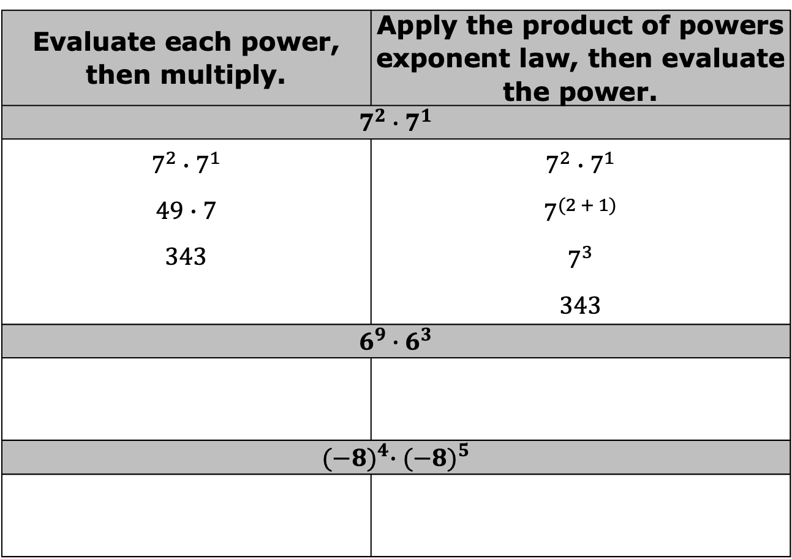
The first expression has been evaluated.
Evaluate each power, then multiply. | Apply the product of powers exponent law, then evaluate the power.
$$7^{2}∙7^{1}$$
$$7^{2}∙7^{1}$$ $$49∙7$$ $$343$$ | $$7^{2}∙7^{1}$$ $$7^{(2 + 1)}$$ $$7^{3}$$ $$343$$
$$6^{9}∙6^{3}$$
$${(−8)}^{4}∙{(−8)}^{5}$$
volume 1, pg. 101

Slide 14
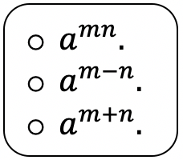
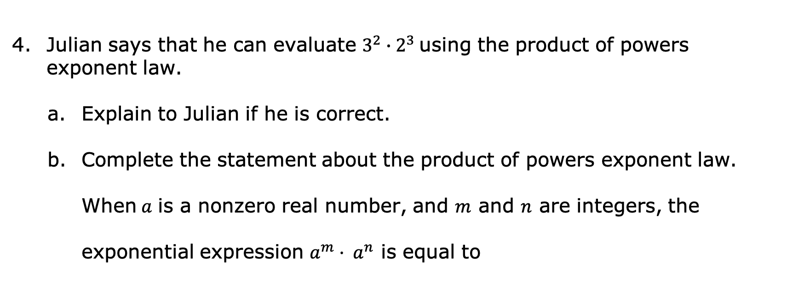
Julian says that he can evaluate $3^{2}∙{ 2}^{3}$using the product of powers exponent law.
Explain to Julian if he is correct.
Complete the statement about the product of powers exponent law.
When$a$ is a nonzero real number, and $m$ and $n$ are integers, the
exponential expression $a^{m}· a^{n}$ is equal to
volume 1, pg. 101

Slide 15
Exploration
volume 1, pg. 102

Slide 16
3.1.3 Exploration: Power of a Product Exponent Law
With your partner, complete the table and answer the questions.
volume 1, pg. 102

Slide 17
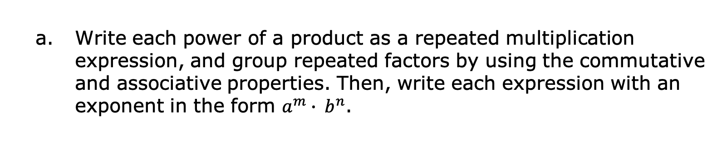
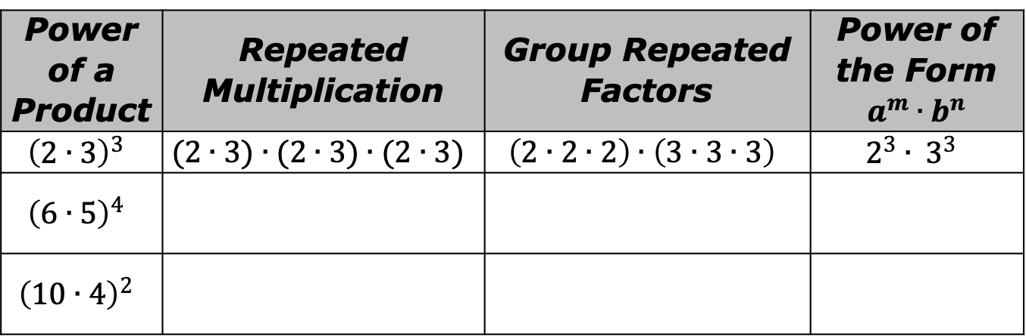
Write each power of a product as a repeated multiplication expression, and group repeated factors by using the commutative and associative properties. Then, write each expression with an exponent in the form $a^{m}∙ b^{n}$.
Power of a Product | Repeated Multiplication | Group Repeated Factors | Power of the Form $$a^{m}∙b^{n}$$
$${\left(2∙3\right)}^{3}$$ | $$(2∙3)∙(2∙3)∙(2∙3)$$ | $$\left(2∙2∙2\right)∙\left(3∙3∙3\right)$$ | $$2^{3}∙ 3^{3}$$
$${\left(6∙5\right)}^{4}$$
$${\left(10∙4\right)}^{2}$$
volume 1, pg. 102

Slide 18
How does the base in the first column relate to the bases in the last column?
How does the exponent in the first column relate to the exponents in the last column?
Write a rule for the power of a product.
volume 1, pg. 102

Slide 19
Power of a Product Exponent Law
When raising a product to a power, distribute the power to each factor.
With your partner, follow the steps.
Determine which column you will start in, and which column your partner will start in.
Using the directions for your column, evaluate the expression. Your partner should use the directions in their column to evaluate the same expression.
Verify if your answers are the same. If not, find the error(s).
After each problem, switch columns.
volume 1, pg. 102

Slide 20
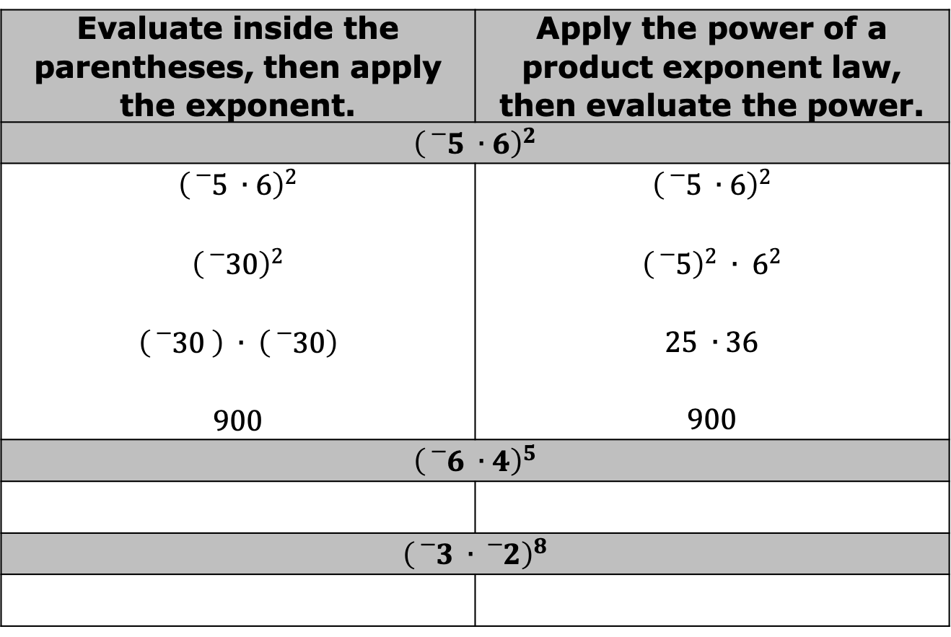
The first expression has been evaluated.
Evaluate inside the parentheses, then apply the exponent. | Apply the power of a product exponent law, then evaluate the power.
$${\left({}_{}^{−}5 ∙6\right)}^{2}$$
$${\left({}_{}^{−}5 ∙6\right)}^{2}$$ $${\left({}_{}^{−}{30}\right)}^{2}$$ $$\left({}_{}^{−}{30 }\right) ∙ \left({}_{}^{−}{30}\right)$$ $$900$$ | $${\left({}_{}^{−}5 ∙6\right)}^{2}$$ $${\left({}_{}^{−}5\right)}^{2} ∙ 6^{2}$$ $$25 ∙36$$ $$900$$
$${\left({}_{}^{−}6 ∙4\right)}^{5}$$
$${\left({}_{}^{−}3 ∙{}_{}^{−}2\right)}^{8}$$
volume 1, pg. 102

Slide 21
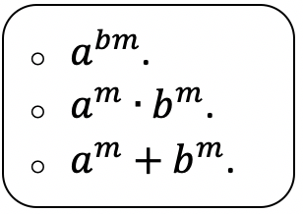
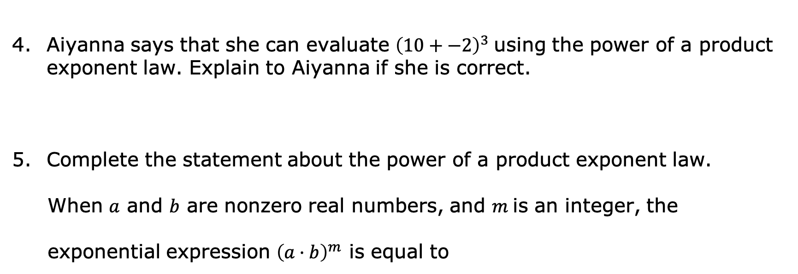
Aiyanna says that she can evaluate ${\left(10+−2\right)}^{3}$using the power of a product exponent law. Explain to Aiyanna if she is correct.
Complete the statement about the power of a product exponent law.
When $a$ and $b$ are nonzero real numbers, and $m$is an integer, the
exponential expression ${\left(a·b\right)}^{m}$ is equal to
volume 1, pg. 103

Slide 22
Exploration
volume 1, pg. 103

Slide 23
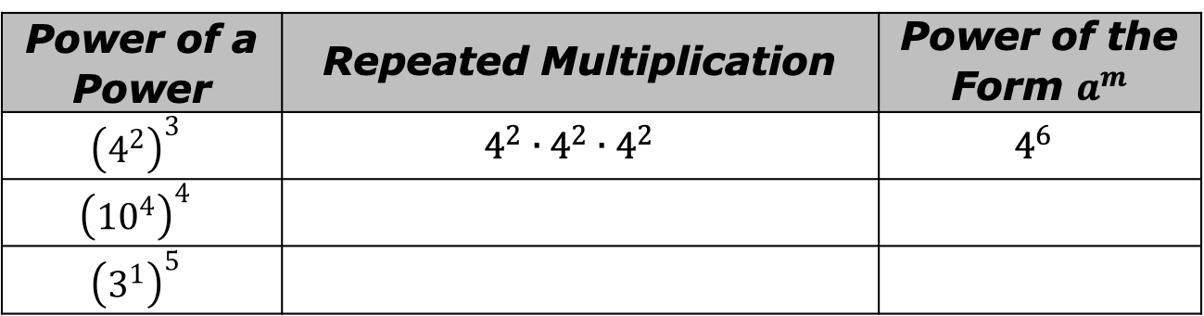
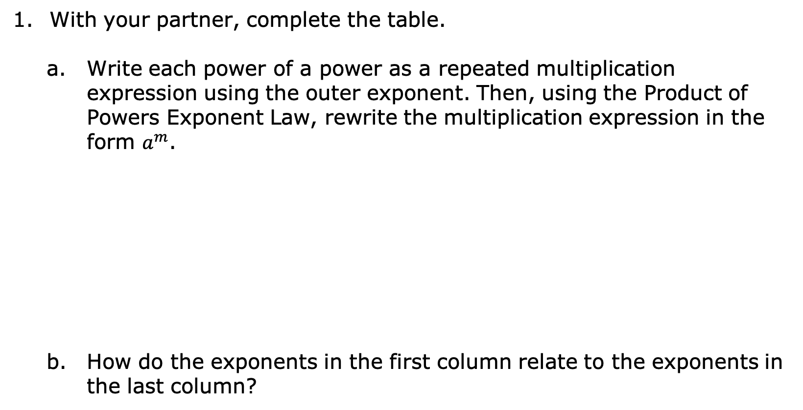
3.1.4 Exploration: Power of a Power Exponent Law
With your partner, complete the table.
Write each power of a power as a repeated multiplication expression using the outer exponent. Then, using the Product of Powers Exponent Law, rewrite the multiplication expression in the form $a^{m}$.
How do the exponents in the first column relate to the exponents in the last column?
Power of a Power | Repeated Multiplication | Power of the Form $a^{m}$
$${\left(4^{2}\right)}^{3}$$ | $$4^{2}∙4^{2}∙4^{2}$$ | $$4^{6}$$
$${\left({10}^{4}\right)}^{4}$$
$${\left(3^{1}\right)}^{5}$$
volume 1, pg. 103

Slide 24
Two different methods for evaluating expressions with exponents are illustrated in the table. With your partner, follow the steps.
Determine which column you will start in, and which column your partner will start in.
Review Method 1 and Method 2. When you are working in each column, make sure to follow the same process as in the example for that column.
After finding the value of each expression, verify your answers are the same. If not, find the error(s).
After each problem, swap columns so that you and your partner are practicing both methods.
volume 1, pg. 103

Slide 25
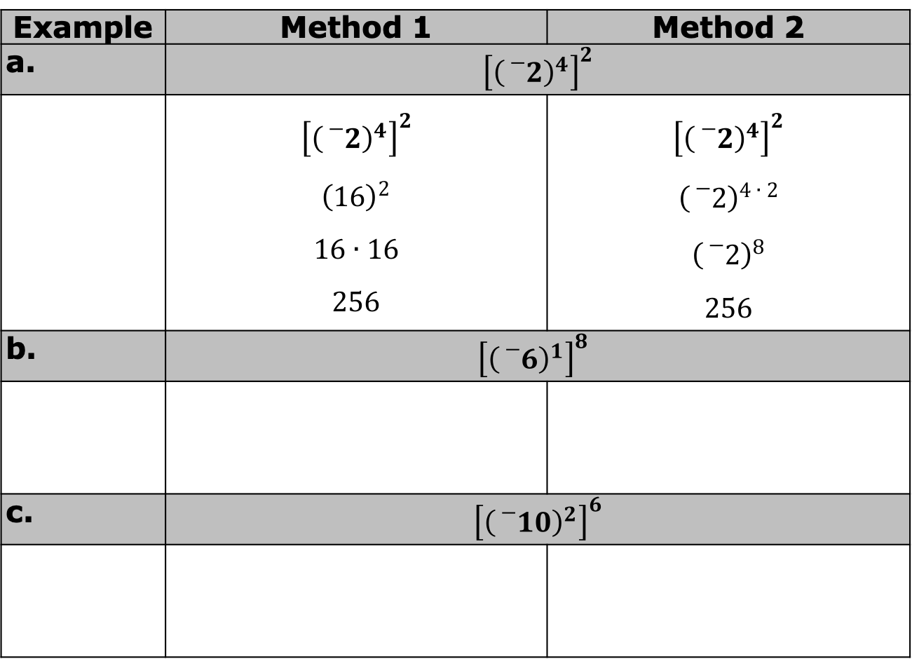
Example | Method 1 | Method 2
 | $${\left[{\left({}_{}^{−}2\right)}^{4}\right]}^{2}$$
 | $${\left[{\left({}_{}^{−}2\right)}^{4}\right]}^{2}$$ $${\left(16\right)}^{2}$$ $$16∙16$$ $$256$$ | $${\left[{\left({}_{}^{−}2\right)}^{4}\right]}^{2}$$ $${\left({}_{}^{−}2\right)}^{4 ∙ 2}$$ $${\left({}_{}^{−}2\right)}^{8}$$ $$256$$
 | $${\left[{\left({}_{}^{−}6\right)}^{1}\right]}^{8}$$
 | $${\left[{\left({}_{}^{−}{10}\right)}^{2}\right]}^{6}$$
volume 1, pg. 104

Slide 26
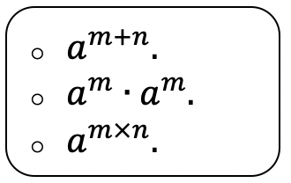
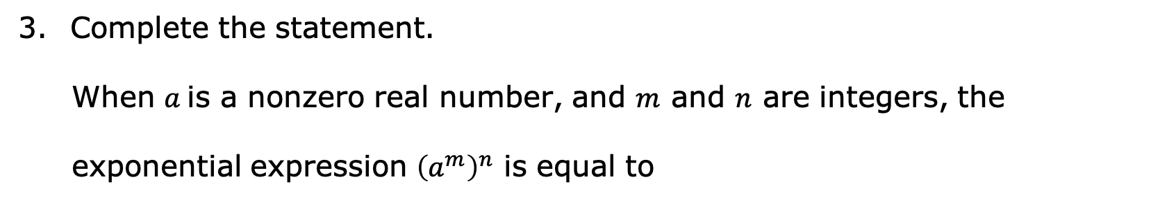
Complete the statement.
When $a$is a nonzero real number, and $m$ and $n$ are integers, the
exponential expression ${\left(a^{m}\right)}^{n}$ is equal to
Power of a Power Exponent Law
When raising a base with a power to another power, multiply the exponents and keep the same base.
volume 1, pg. 104

Slide 27
Exploration
volume 1, pg. 104

Slide 28
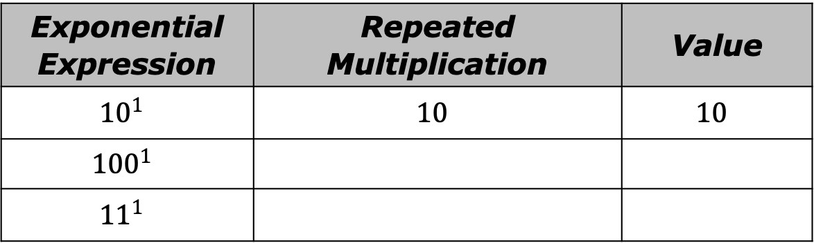
3.1.5 Exploration: Identity Exponent Law
With your partner, use the meaning of an exponent to complete the table. Write each product as a repeated multiplication expression, then write the value of each expression.
Exponential Expression | Repeated Multiplication | Value
$${10}^{1}$$ | $$10$$ | $$10$$
$${100}^{1}$$
$${11}^{1}$$
volume 1, pg. 104

Slide 29
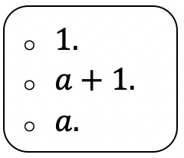
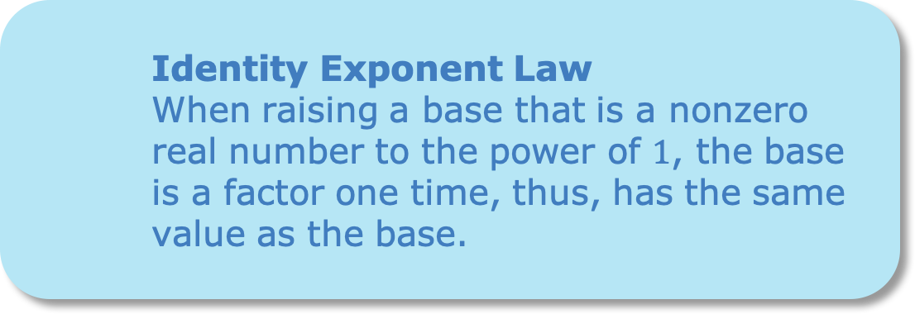
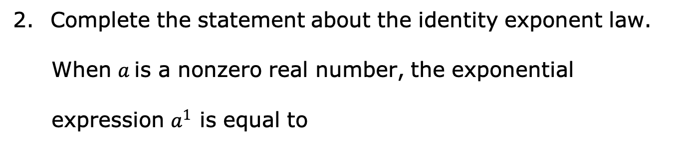
Complete the statement about the identity exponent law.
When $a$is a nonzero real number, the exponential
expression $a^{1}$ is equal to
Identity Exponent Law
When raising a base that is a nonzero real number to the power of $1$, the base is a factor one time, thus, has the same value as the base.
volume 1, pg. 104

Slide 30

Your Turn
volume 1, pg. 105

Slide 31
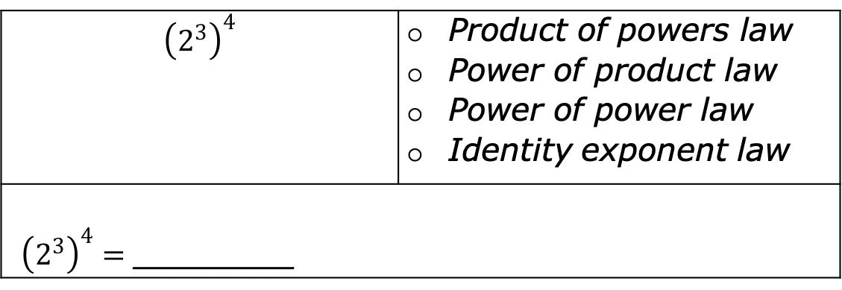
3.1.6 Your Turn!
Complete the following steps for each expression.
Rewrite each expression shown by using the laws of exponents.
Choose the exponent law you used from the list.
Evaluate the exponential expression.
$${\left(2^{3}\right)}^{4}$$ | Product of powers law Power of product law Power of power law Identity exponent law
${\left(2^{3}\right)}^{4}=$ ________
volume 1, pg. 105

Slide 32
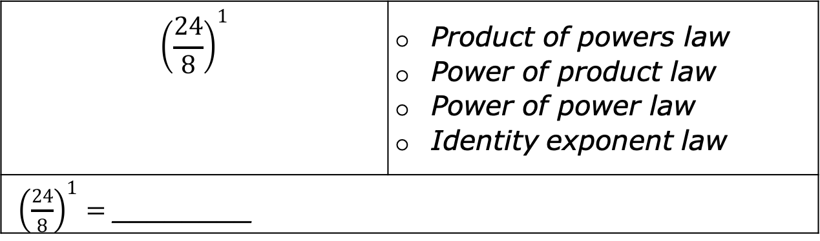
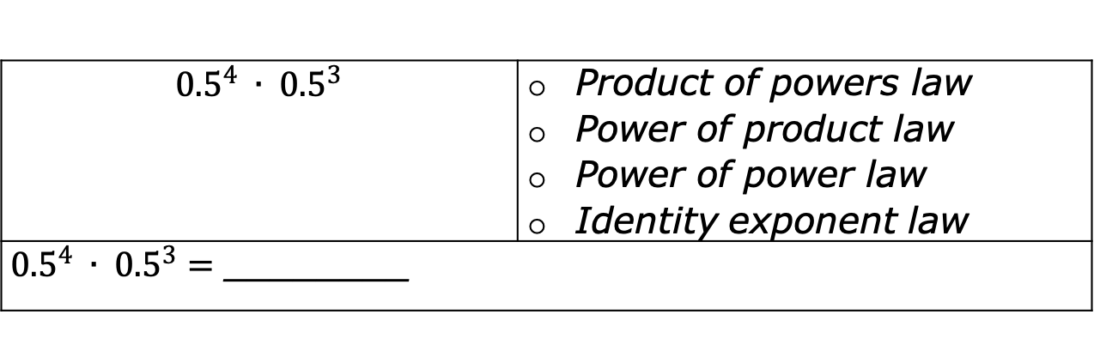
$${0.5}^{4} ∙ {0.5}^{3}$$ | Product of powers law Power of product law Power of power law Identity exponent law
${0.5}^{4} ∙ {0.5}^{3}=$ ________
$${\left(\frac{24}{8}\right)}^{1}$$ | Product of powers law Power of product law Power of power law Identity exponent law
${\left(\frac{24}{8}\right)}^{1}=$ ________
volume 1, pg. 105

Slide 33
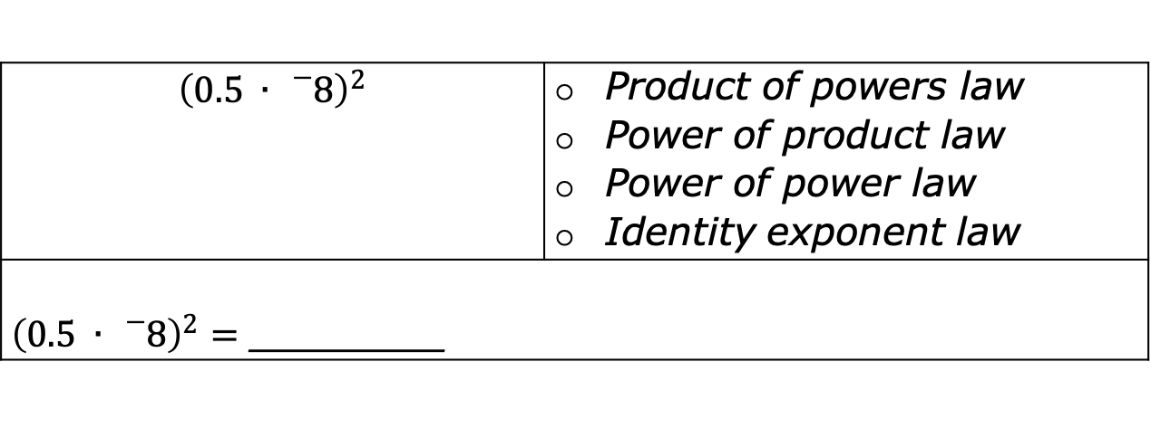
$${\left(0.5 ∙ {}_{}^{−}8\right)}^{2}$$ | Product of powers law Power of product law Power of power law Identity exponent law
${\left(0.5 ∙ {}_{}^{−}8\right)}^{2}=$ ________
volume 1, pg. 105

Slide 34

Wrap-Up
volume 1, pg. 105

Slide 35
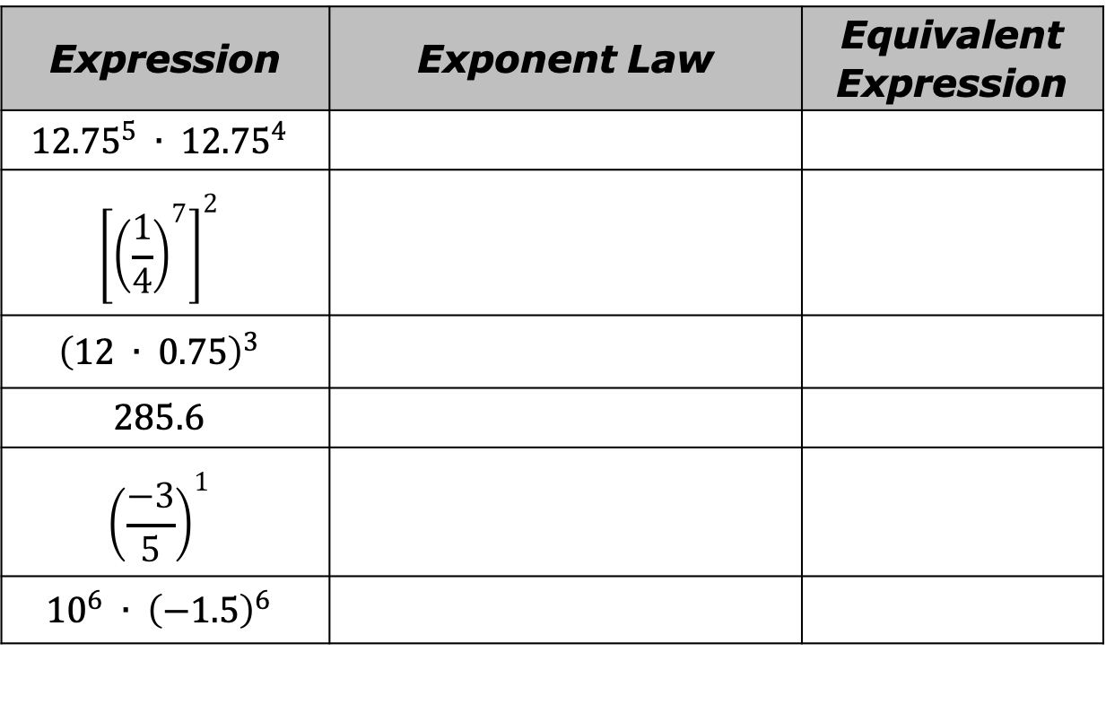
3.1.7 Wrap-Up: Ticket Out the Door
Rewrite the expressions using laws of exponents. State the exponent law used.
Expression | Exponent Law | Equivalent Expression
$${12.75}^{5} ∙ {12.75}^{4}$$
$${\left[{\left(\frac{1}{4}\right)}^{7}\right]}^{2}$$
$${\left(12 ∙ 0.75\right)}^{3}$$
$$285.6$$
$${\left(\frac{−3}{5}\right)}^{1}$$
$${10}^{6} ∙ {\left(−1.5\right)}^{6}$$
volume 1, pg. 105

